Slide 1


Project – “Online Shopping System” in mysql -Nutan Zine

Slide 2

Introduction
Product Catalogues: A wide range of products displayed with detailed descriptions, images, prices, and availability.
User Accounts: Customers can create personal accounts to track their orders, save payment methods, and receive recommendations based on previous purchases.
Shopping Cart: A virtual cart where customers can add items before proceeding to checkout.
Payment Gateway Integration: Secure processing of online payments through various methods like credit/debit cards, digital wallets, and net banking.
Order Management: Customers can view their order history, track the status of current orders, and manage returns or exchanges.

Slide 3

Description Of an ER Diagram :
In an online shopping system, the following main entities are typically involved: 1.Category 2.Supplier 3.Product 4.Customer 5.'Order' 6.OrderDetail 7.Payment.

Slide 4
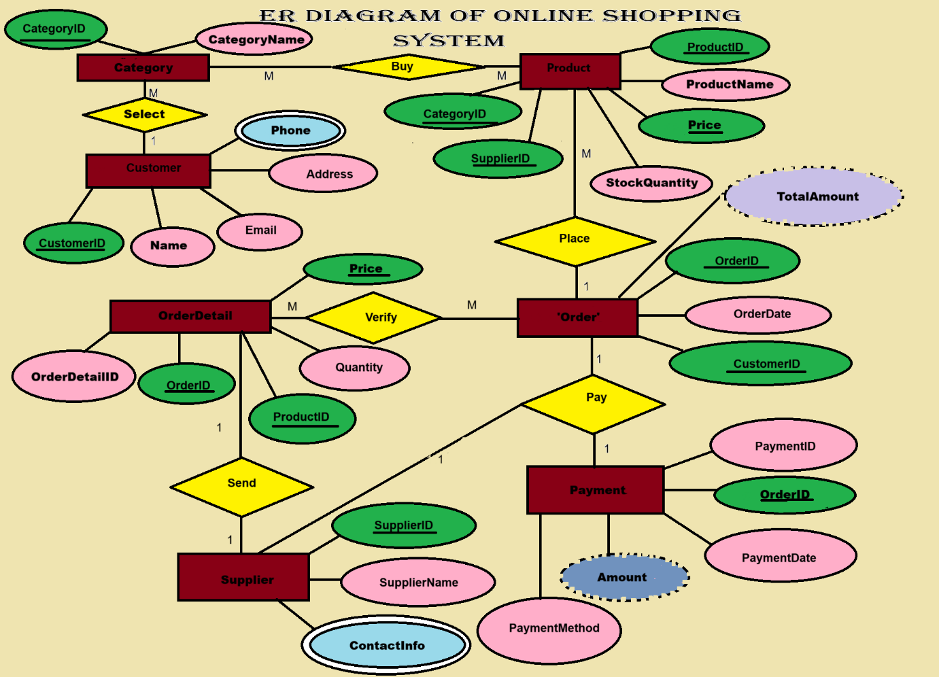


Slide 5

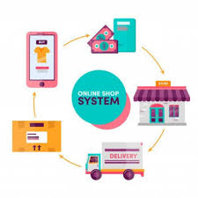
SQL Query :

Slide 6
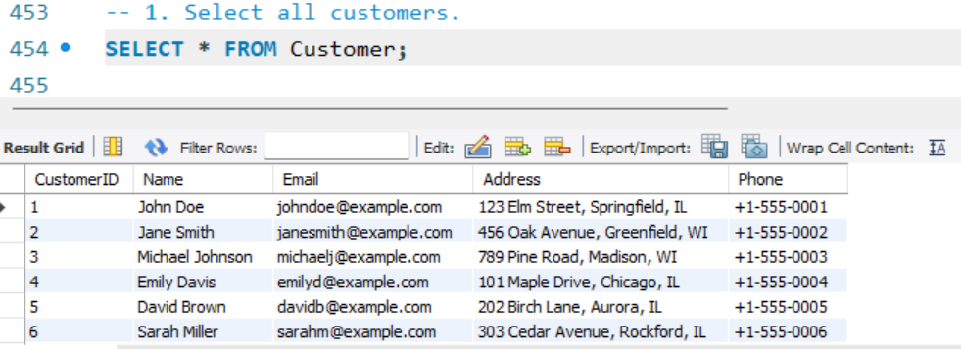
Here are 20 SQL queries that I can use for various operations in an Online Shopping System.

Slide 7
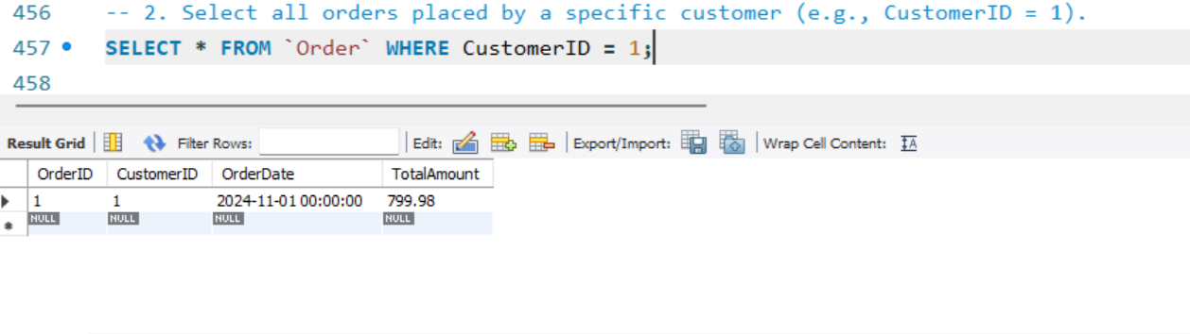
selecting visual aids
ENHANCING YOUR PRESENTATION

Slide 8
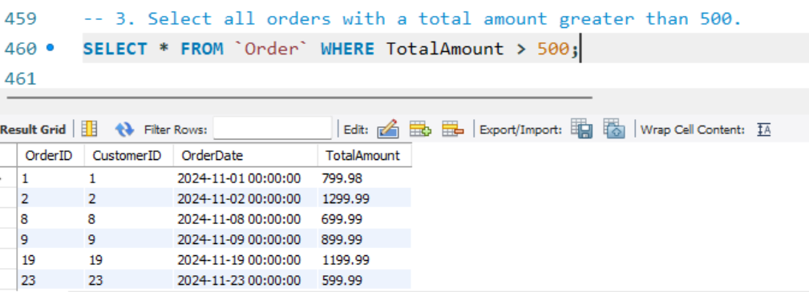
effective delivery techniques
Effective body language enhances your message, making it more impactful and memorable:
Meaningful eye contact
Purposeful gestures
Maintain good posture
Control your expressions
This is a powerful tool in public speaking. It involves varying pitch, tone, and volume to convey emotion, emphasize points, and maintain interest:
Pitch variation
Tone inflection
Volume control

Slide 9
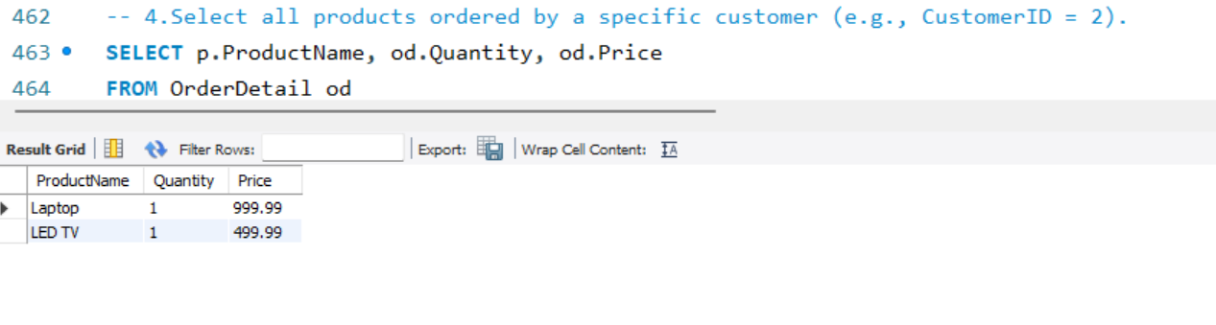
navigating q&a sessions
Know your material in advance
Anticipate common questions
Rehearse your responses
Maintaining composure during the Q&A session is essential for projecting confidence and authority. Consider the following tips for staying composed:
Stay calm
Actively listen
Pause and reflect
Maintain eye contact

Slide 10

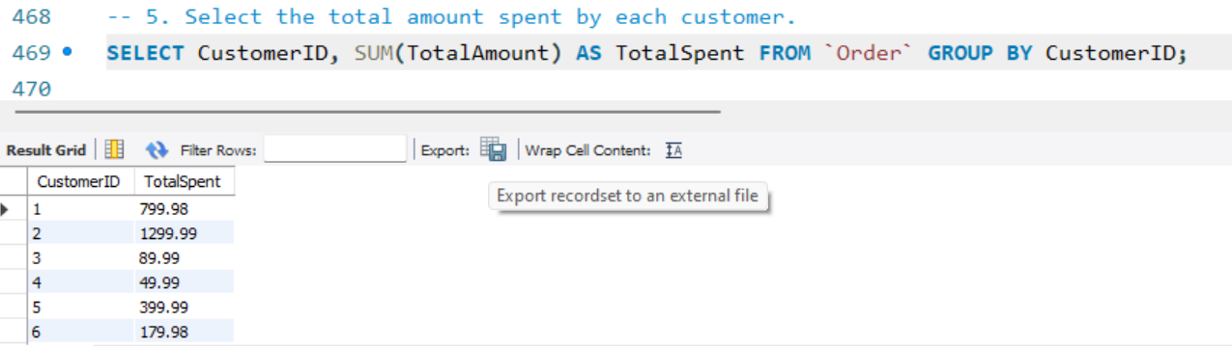
speaking impact
Your ability to communicate effectively will leave a lasting impact on your audience
Effectively communicating involves not only delivering a message but also resonating with the experiences, values, and emotions of those listening

Slide 11
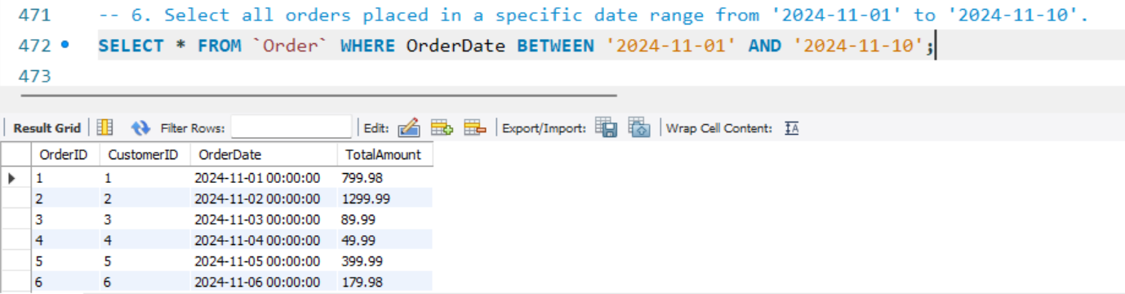
speaking impact
Learn to infuse energy into your delivery to leave a lasting impression
One of the goals of effective communication is to motivate your audience
METRIC | MEASUREMENT | TARGET | ACTUAL
Audience attendance | # of attendees | 150 | 120
Engagement duration | Minutes | 60 | 75
Q&A interaction | # of questions | 10 | 15
Positive feedback | Percentage (%) | 90 | 95
Rate of information retention | Percentage (%) | 80 | 85

Slide 12
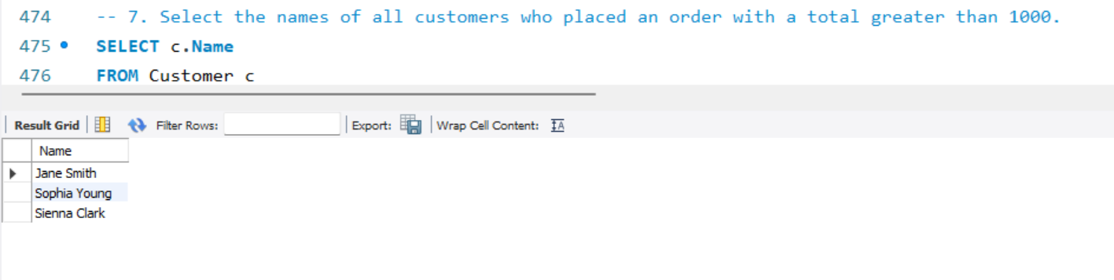
final tips & takeaways
CONSISTENT REHEARSAL
Strengthen your familiarity
REFINE DELIVERY STYLE
Pacing, tone, and emphasis
TIMING AND TRANSITIONS
Aim for seamless, professional delivery
PRACTICE AUDIENCE
Enlist colleagues to listen & provide feedback
Seek feedback
Reflect on performance
Explore new techniques
Set personal goals
Iterate and adapt

Slide 13
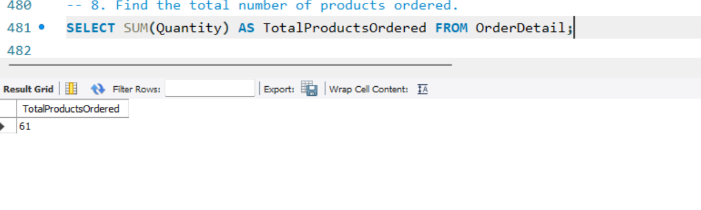
final tips & takeaways
CONSISTENT REHEARSAL
Strengthen your familiarity
REFINE DELIVERY STYLE
Pacing, tone, and emphasis
TIMING AND TRANSITIONS
Aim for seamless, professional delivery
PRACTICE AUDIENCE
Enlist colleagues to listen & provide feedback
Seek feedback
Reflect on performance
Explore new techniques
Set personal goals
Iterate and adapt

Slide 14
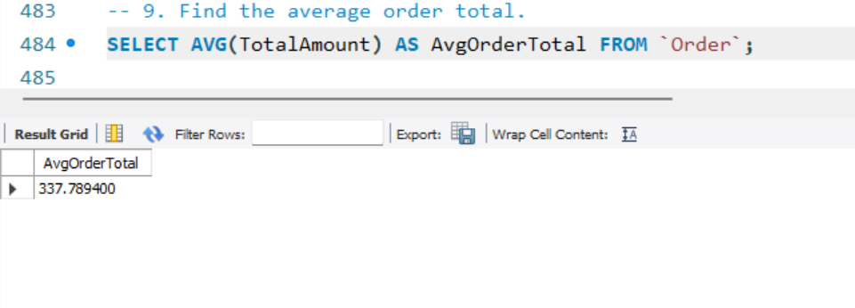
final tips & takeaways
CONSISTENT REHEARSAL
Strengthen your familiarity
REFINE DELIVERY STYLE
Pacing, tone, and emphasis
TIMING AND TRANSITIONS
Aim for seamless, professional delivery
PRACTICE AUDIENCE
Enlist colleagues to listen & provide feedback
Seek feedback
Reflect on performance
Explore new techniques
Set personal goals
Iterate and adapt

Slide 15
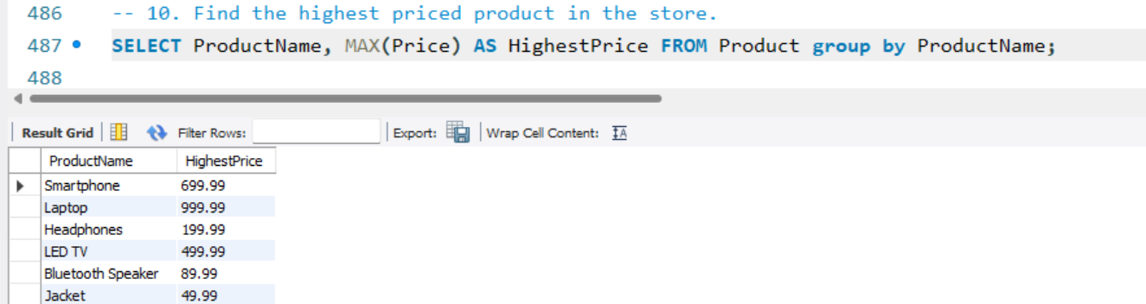
final tips & takeaways
CONSISTENT REHEARSAL
Strengthen your familiarity
REFINE DELIVERY STYLE
Pacing, tone, and emphasis
TIMING AND TRANSITIONS
Aim for seamless, professional delivery
PRACTICE AUDIENCE
Enlist colleagues to listen & provide feedback
Seek feedback
Reflect on performance
Explore new techniques
Set personal goals
Iterate and adapt

Slide 16
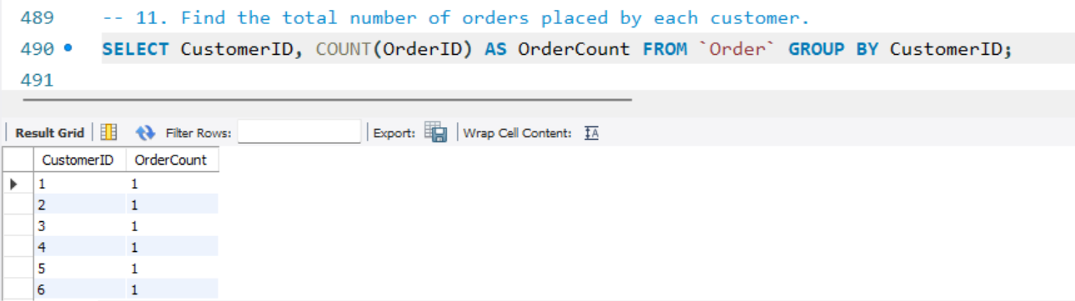
final tips & takeaways
CONSISTENT REHEARSAL
Strengthen your familiarity
REFINE DELIVERY STYLE
Pacing, tone, and emphasis
TIMING AND TRANSITIONS
Aim for seamless, professional delivery
PRACTICE AUDIENCE
Enlist colleagues to listen & provide feedback
Seek feedback
Reflect on performance
Explore new techniques
Set personal goals
Iterate and adapt

Slide 17
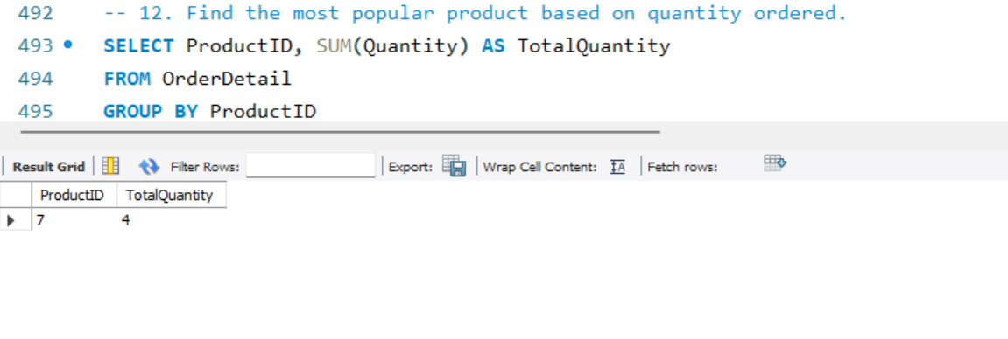
final tips & takeaways
CONSISTENT REHEARSAL
Strengthen your familiarity
REFINE DELIVERY STYLE
Pacing, tone, and emphasis
TIMING AND TRANSITIONS
Aim for seamless, professional delivery
PRACTICE AUDIENCE
Enlist colleagues to listen & provide feedback
Seek feedback
Reflect on performance
Explore new techniques
Set personal goals
Iterate and adapt

Slide 18
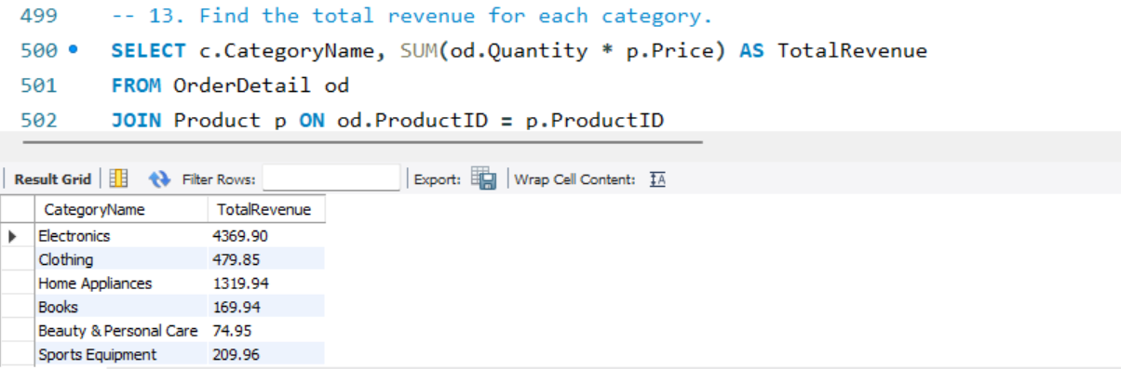
final tips & takeaways
CONSISTENT REHEARSAL
Strengthen your familiarity
REFINE DELIVERY STYLE
Pacing, tone, and emphasis
TIMING AND TRANSITIONS
Aim for seamless, professional delivery
PRACTICE AUDIENCE
Enlist colleagues to listen & provide feedback
Seek feedback
Reflect on performance
Explore new techniques
Set personal goals
Iterate and adapt

Slide 19
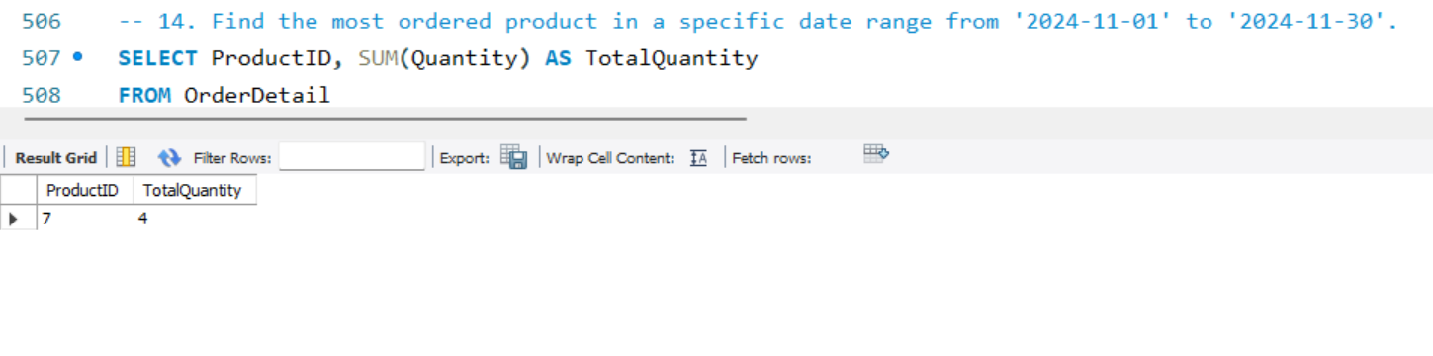
final tips & takeaways
CONSISTENT REHEARSAL
Strengthen your familiarity
REFINE DELIVERY STYLE
Pacing, tone, and emphasis
TIMING AND TRANSITIONS
Aim for seamless, professional delivery
PRACTICE AUDIENCE
Enlist colleagues to listen & provide feedback
Seek feedback
Reflect on performance
Explore new techniques
Set personal goals
Iterate and adapt

Slide 20
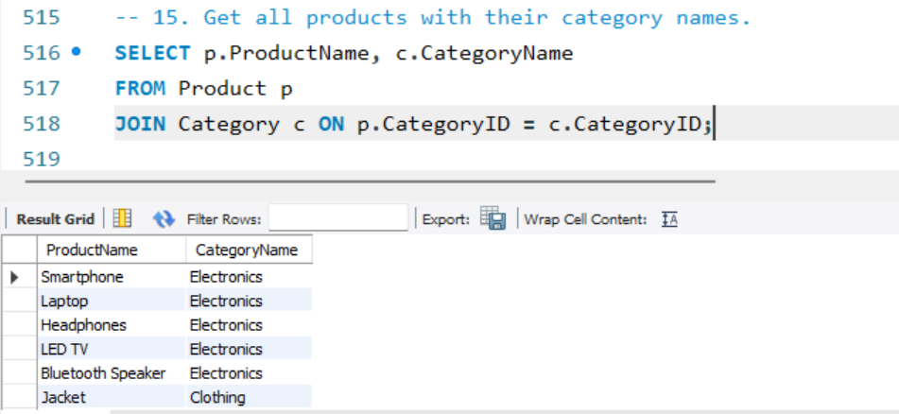
final tips & takeaways
CONSISTENT REHEARSAL
Strengthen your familiarity
REFINE DELIVERY STYLE
Pacing, tone, and emphasis
TIMING AND TRANSITIONS
Aim for seamless, professional delivery
PRACTICE AUDIENCE
Enlist colleagues to listen & provide feedback
Seek feedback
Reflect on performance
Explore new techniques
Set personal goals
Iterate and adapt

Slide 21
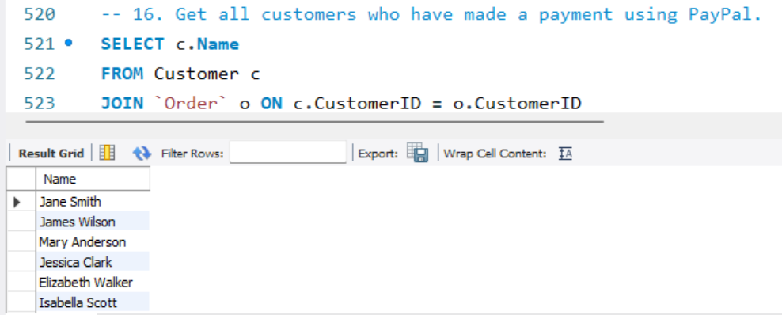
final tips & takeaways
CONSISTENT REHEARSAL
Strengthen your familiarity
REFINE DELIVERY STYLE
Pacing, tone, and emphasis
TIMING AND TRANSITIONS
Aim for seamless, professional delivery
PRACTICE AUDIENCE
Enlist colleagues to listen & provide feedback
Seek feedback
Reflect on performance
Explore new techniques
Set personal goals
Iterate and adapt

Slide 22
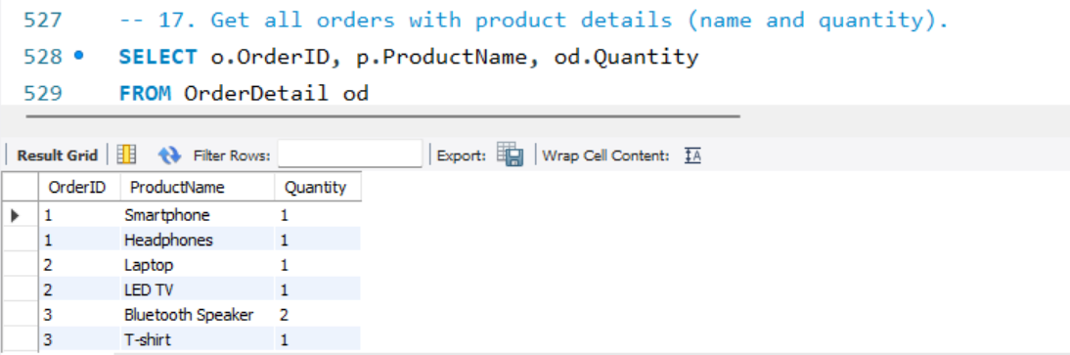
final tips & takeaways
CONSISTENT REHEARSAL
Strengthen your familiarity
REFINE DELIVERY STYLE
Pacing, tone, and emphasis
TIMING AND TRANSITIONS
Aim for seamless, professional delivery
PRACTICE AUDIENCE
Enlist colleagues to listen & provide feedback
Seek feedback
Reflect on performance
Explore new techniques
Set personal goals
Iterate and adapt

Slide 23

final tips & takeaways
CONSISTENT REHEARSAL
Strengthen your familiarity
REFINE DELIVERY STYLE
Pacing, tone, and emphasis
TIMING AND TRANSITIONS
Aim for seamless, professional delivery
PRACTICE AUDIENCE
Enlist colleagues to listen & provide feedback
Seek feedback
Reflect on performance
Explore new techniques
Set personal goals
Iterate and adapt

Slide 24
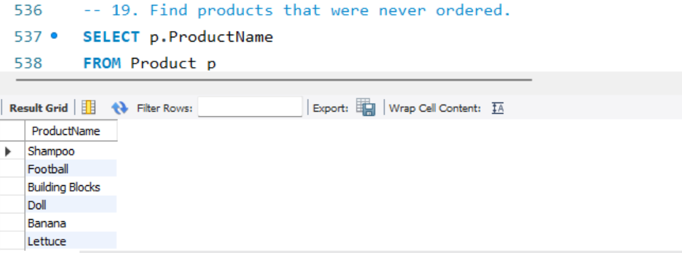
final tips & takeaways
CONSISTENT REHEARSAL
Strengthen your familiarity
REFINE DELIVERY STYLE
Pacing, tone, and emphasis
TIMING AND TRANSITIONS
Aim for seamless, professional delivery
PRACTICE AUDIENCE
Enlist colleagues to listen & provide feedback
Seek feedback
Reflect on performance
Explore new techniques
Set personal goals
Iterate and adapt

Slide 25
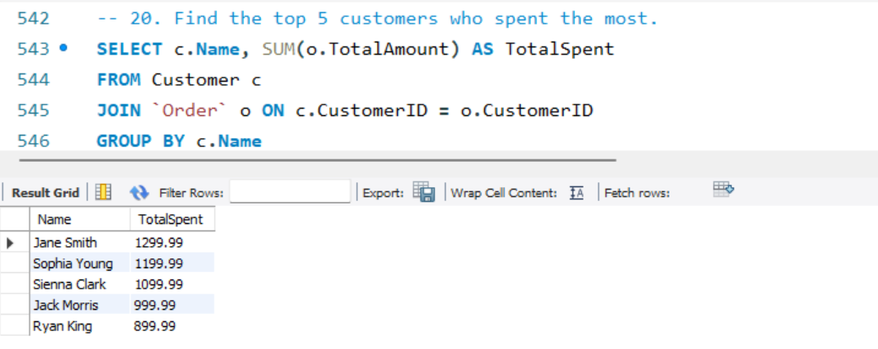
speaking engagement metrics
IMPACT FACTOR | MEASUREMENT | TARGET | ACHIEVED
Audience interaction | Percentage (%) | 85 | 88
Knowledge retention | Percentage (%) | 75 | 80
Post-presentation surveys | Average rating | 4.2 | 4.5
Referral rate | Percentage (%) | 10 | 12
Collaboration opportunities | # of opportunities | 8 | 10

Slide 26
Insights :
Ease of Use: A user-friendly interface is crucial. Customers should be able to navigate the system intuitively, from browsing products to completing checkout without frustration.
Personalization: Implementing recommendation engines can significantly enhance the user experience by showing products tailored to individual preferences, based on browsing history and past purchases.
Mobile Responsiveness: A growing number of users shop via smartphones and tablets. An online shopping system should be responsive, ensuring that the design works well across all devices.

Slide 27
Conclusion :
The Online Shopping System project has demonstrated the significant impact and potential of e-commerce platforms in the modern retail landscape. By integrating key features such as a user-friendly interface, secure payment gateways, real-time inventory management, and personalized product recommendations, the system facilitates a seamless shopping experience for customers. The project also highlights the importance of security, scalability, and effective customer support to ensure customer trust and satisfaction.

Slide 28

thank you
BRITA TAMM
502-555-0152
brita@firstupconsultants.com
www.firstupconsultants.com
Thank
You

